Slide 1
HDL Workflow Tools

Slide 2
PXIe-7903 Aurora HDL
LV generated HDL
Fixed logic HDL
Reuse LV Window Code
User custom HDL
Today
Tech Preview
HDL TOP LEVEL
HDL TOP LEVEL
LV WINDOW
LV WINDOW
Fixed
Logic
Aurora Top VI
Fixed
Logic
Aurora Top VI
Aurora IDL
Aurora IDL
Host Interface
Host Interface
8
7
3
2
17
17
9
8
7
3
2
17
17
9
TX RX NFC Errors CtrlAxi DrpAxi Misc
…
TX RX NFC Errors CtrlAxi DrpAxi Misc
…
Aurora Port #1
#12
Aurora Port #1
#12
PCIe
IO
PCIe
IO
2
2
2
4
5
4
6
8
8
20
3
LmkI2C
LmkPdn
LmkGpio
LmkStatus
Ipass
PortExp
Mgt
HostAxi
DiagramAxi
ClipAxi
Misc
2
2
2
4
5
4
6
8
8
20
3
LmkI2C
LmkPdn
LmkGpio
LmkStatus
Ipass
PortExp
Mgt
HostAxi
DiagramAxi
ClipAxi
Misc
Board IO
Aurora Port
#1
Board IO
Aurora Port
#1
Reuse Aurora
CLIP Code
…
…
#12
#12

Slide 3
User Tools
Tool | Purpose
projectsettings.ini | Specify tool versions, Vivado project settings, and HDL file paths used by the user tools
vivadoprojectsources.txt vivadoprojectdeps.txt | List source and dependency HDL files
setenv.bat | Put tools into the command prompt path
extractdependencies.bat | Extract the dependencies zip file into the correct location
createvivadoproject.bat | Creates a Vivado project based on parameters and files specified in projectsettings.ini
launchvivado.bat | Launches the desired version of Vivado
migrateclip.bat | Converts CLIP HDL and XML files into code that can be used in the HDL workflow
genlvtargetsupport.bat | Generate LV FPGA target plugin files
installlvtargetsupport.bat | Install LV FPGA target plugin files into the LVAddons folder
extractlvwindow.bat | Extract the LV Window netlist and other files from a LV Vivado Project Export
Vivado | Build and debug FPGA bitstreams
LabVIEW | Author LV code, generate HDL for use in HDL workflow, build bitfiles

Slide 4
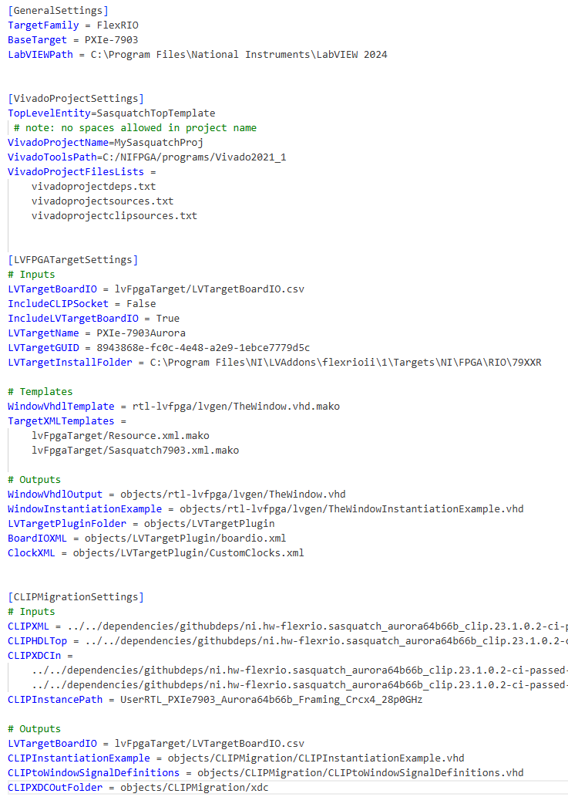
projectsettings.ini

Slide 5
projectsettings.ini
General Settings
Vivado Project Settings
createvivadoproject.bat
LVFPGA Target Settings
genlvtargetsupport.bat
CLIP Migration Settings
migrateclip.bat

Slide 6
Project Settings UX
Command Line
genlvtargetsupport.bat
Each section is for a different function
Functions generally process input files and generate output files
Balance hard-coding paths and file names vs. leaving them as settings in the ini file
Standard flow uses default file locations and manually runs functions from the command line
Functions can be automated into a customer’s toolchain with customized file paths
Considering passing parameters or the path to an ini file into the functions
input
output
Customer Build Process
input
genlvtarget
support.bat
output

Slide 7
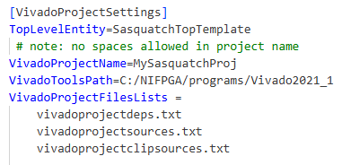


createvivadoproject.bat
projectsettings.ini
specify desired Vivado installed version to use
vivadoprojecdeps.txt
dependency files copied into flat gathereddeps folder to avoid long file path problems
../../deps/githubdeps/dram/ … long path … /dram2DP.vhd
../../deps/githubdeps/fpga/ ... long path … /flop.vhd
gathereddeps
vivadoprojecsources.txt
../common/rtl-lvfpga/buffers.vhd
../rtl-lvfpga/sasquatchtop.vhd
gathereddeps files used for Vivado project
source files referenced in place
VivadoProject
createvivadoproject.tcl
add file ../rtl-lvfpga/sasquatchtop.vhd
add file ../objects/gathereddeps/flop.vhd
TCL script creates Vivado project files
TCL script is generated based on source and deps files

Slide 8
launchvivado.bat
projectsettings.ini
opens this project
executes this install of Vivado
We have this helper script because many users will have LV FPGA Compile Tools install Vivado which doesn’t put shortcuts on the desktop or Start menu
Different projects may use different versions of Vivado and this will ensure that you always use the correct one

Slide 9
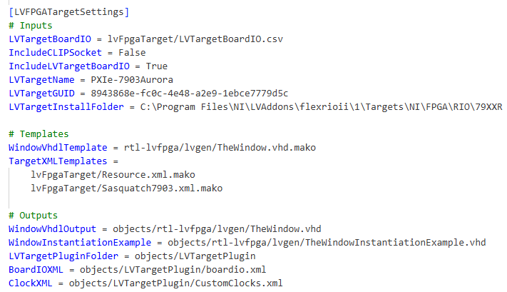

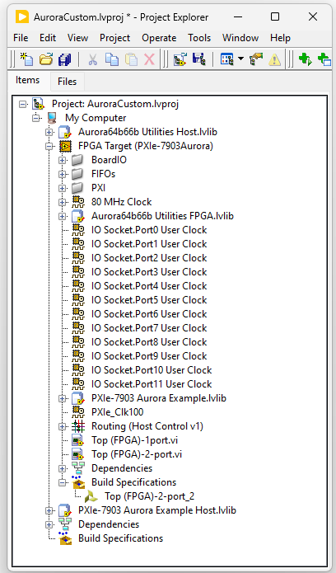
genlvtargetsupport.bat
GitHub source code folder
projectsettings.ini
pxie-7903
genlvtargetsupport.bat
LV FPGA target plugin folder
LV FPGA target plugins installed in Program Files
pxie-7903
LVAddons
pxie-7903
installlvtargetsupport.bat
copies plugin folder into LVAddons install location
Resource.xml
Defines target interfaces for LabVIEW FPGA project items

Slide 10
genlvtargetsupport.bat
FPGA Target with CLIP
FPGA Target with custom HDL
HDL TOP LEVEL
HDL TOP LEVEL
LV WINDOW
Custom HDL Region
LV WINDOW
Fixed
Logic
THE VI – Required
Fixed
Logic
THE VI – Optional
Host
Interfaces
IPIN
Host
Interfaces
LV SubVI IP
Host Interface
Host Interface
Signals
Signals
IPIN
Registers
Registers
PCIe
DMA
Signals
PCIe
DMA
FIFOs
FIFOs
THE CLIPs
Host
Interfaces
Custom
CLIP HDL
Board IO
Signals
Board IO

Slide 11
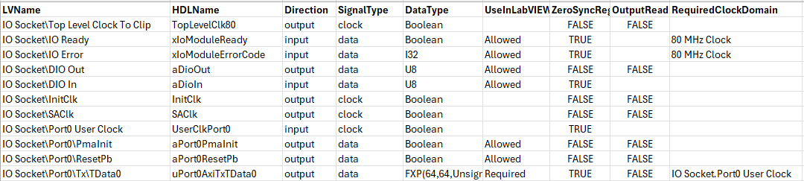
genlvtargetsupport.bat
projectsettings.ini
LVTargetBoardIO.csv
FPGA Target with CLIP
FPGA Target with custom HDL
IncludeLVTargetBoardIO
HDL TOP LEVEL
Resource XML
TheWindow.vhd
(stub)
HDL TOP LEVEL
LV WINDOW
Custom HDL Region
LV WINDOW
Fixed
Logic
THE VI – Required
Fixed
Logic
THE VI – Optional
Host
Interfaces
IPIN
Host
Interfaces
LV SubVI IP
Host Interface
Host Interface
Signals
Signals
IPIN
Registers
Registers
PCIe
DMA
Signals
PCIe
DMA
FIFOs
FIFOs
IncludeCLIPSocket
THE CLIPs
Host
Interfaces
Custom
CLIP HDL
Board IO
Signals
Board IO

Slide 12
migrateclip.bat
CLIP code in LV Window
CLIP code in top-level HDL
HDL TOP LEVEL
HDL TOP LEVEL
TheWindow.vhd
TheWindow.vhd
Top Level VI
Top Level VI
Board IO
The CLIPs
Board IO
CLIP HDL
CLIP HDL
Fixed
Logic
Fixed
Logic

Slide 13
migrateclip.bat
CLIP code in LV Window
CLIP code in top-level HDL
HDL TOP LEVEL
HDL TOP LEVEL
TheWindow.vhd
TheWindow.vhd
Top Level VI
Top Level VI
Board IO LabVIEW Interfaces
Board IO LabVIEW Interfaces
Board IO
The CLIPs
CLIP
LabVIEW Interfaces
Board IO
LVTargetBoardIO.csv
Manually connected
in top-level
CLIP HDL
CLIP HDL
Fixed
Logic
Fixed
Logic
CLIP XML
HDL Instantiation Examples
CLIP Fabric and Socket Interfaces
Manually connected in top-level
CLIP XML

Slide 14
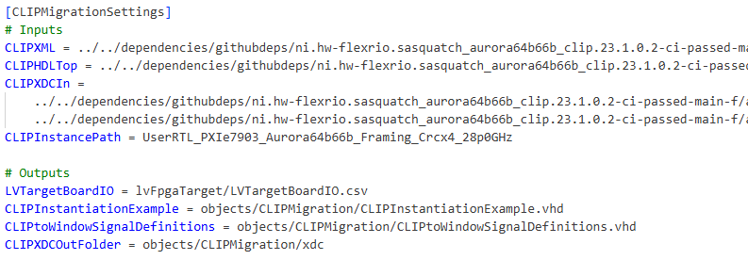
migraeteclip.bat
projectsettings.ini
Aurora CLIP source code
Aurora_CLIP
XML
HDL
XDC
migrateclip.bat
LVTargetBoardIO.csv
HDL instantiation examples
XDC file(s)

Slide 15

extractlvwindow.bat (concept)
ProjectExport
Vivado Project Export
CodeGenResults.lvtxt
extractlvwindow.bat
HDL
XDC
XPR
TheWindowConstraints.XDC
extractwindow.tcl
CodeGenResults.lvtxt
Set TheWindow entity as top level
Synthesize
Open synth run results
Export netlist
TheWindow.EDF
HDL TOP LEVEL
LV WINDOW
Fixed
Logic
Custom HDL
Region
LV WINDOW
THE VI
THE VI
Host Interface

Slide 16
Tool Flow – Sasquatch CLIP Migration
Reuse LV Window Code
Tech Preview
Create Vivado Project
Command Line
HDL TOP LEVEL
Migrate CLIP
Command Line
LV WINDOW
Fixed
Logic
Aurora Top VI
Aurora IDL
Modify target HDL
Host Interface
Text Editor
8
7
3
2
17
17
9
Synthesize (to check HDL)
Vivado
TX RX NFC Errors CtrlAxi DrpAxi Misc
…
Generate LV FPGA Target
Command Line
Aurora Port #1
#12
PCIe
IO
2
2
2
4
5
4
6
8
8
20
3
LmkI2C
LmkPdn
LmkGpio
LmkStatus
Ipass
PortExp
Mgt
HostAxi
DiagramAxi
ClipAxi
Misc
Write top-level VI
LabVIEW
Reuse Aurora
CLIP Code
Vivado Project Export
LabVIEW
Board IO
Aurora Port
#1
Extract LV Window
Command Line
Build Bitfile
Vivado
…
#12

Slide 17
Tool Flow – Sasquatch CLIP Migration
Legend
Source Code
Dependency on Export
Create Vivado Project
Command Line
Project Settings INI
Object
Migrate CLIP
Command Line
Target
HDL Source
Code
Vivado Project
Modify target HDL
Text Editor
Synthesize (to check HDL)
Vivado
Target
Dependencies
Code
Generate LV FPGA Target
Command Line
Gathered Deps Folder
Write top-level VI
LabVIEW
CLIP
Code
Vivado Project Export
TheWindow.vhd
Stub
LabVIEW
FPGA Bitfile
Extract LV Window
Command Line
LV Target Board IO CSV
Resource
XML
LV FPGA
Target Plugin
Build Bitfile
Vivado
LabVIEW Project and VIs
LV Window Netlist

Slide 18
Tool Flow – New HDL-only Target
Legend
Source Code
Dependency on Export
Create Vivado Project
Command Line
Project Settings INI
Object
Modify target HDL
Text Editor
Target
HDL Source
Code
Vivado Project
Build Bitfile
Vivado
Target
Dependencies
Code
Gathered Deps Folder
FPGA Bitfile

Slide 19
Tool Flow – New HDL-and-LV Target
Legend
Source Code
Dependency on Export
Create Vivado Project
Command Line
Project Settings INI
Object
Modify target HDL
Text Editor
Target
HDL Source
Code
Vivado Project
Write subVI
LabVIEW
Add VI Netlist to HDL
Text Editor
Target
Dependencies
Code
Build Bitfile
Vivado
Gathered Deps Folder
FPGA Bitfile
LabVIEW Project and VIs
LV SubVI
Netlist

